Slide 1
Arrays
A sequence of Values

Slide 2
What is an array?
Arrays are a sequence of values of a single type.
Arrays are like a list of common data type

Slide 3
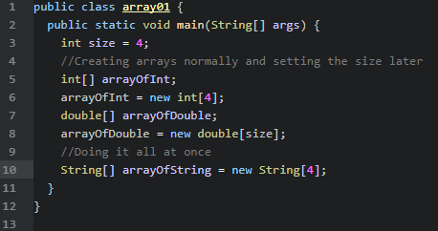
How to create arrays and array types
Arrays in Java are created using square brackets []
These square brackets go next to the variable type which will make it an array of that type
They can also create arrays and assign them a size in a single line

Slide 4
Elements of an array
Elements is the computer science term of values that are stored in an array
1 | 2 | 3 | 4 | 5

Slide 5
Accessing elements of an array
The key thing about accessing elements in arrays is that index always starts at 0
This ‘count’ is what we call a index
Elements | 1 | 2 | 3 | 4 | 5
Count (index) | 0 | 1 | 2 | 3 | 4

Slide 6
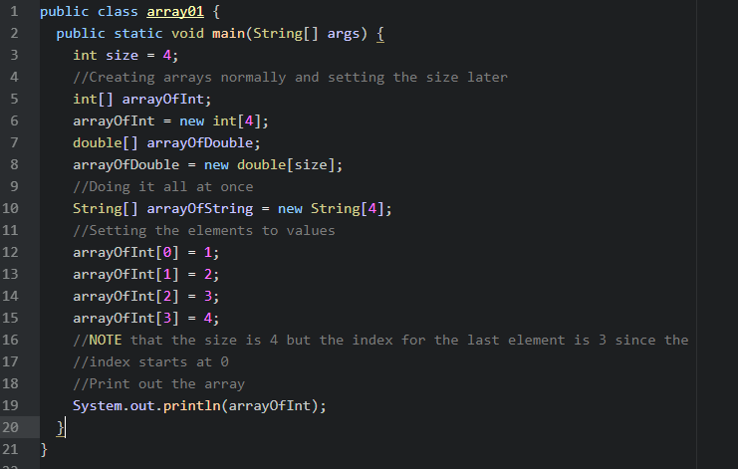
Using index
We can now use this index to manipulate elements within our array and print out the values

Slide 7

Printing arrays
However, printing out the array gives us an error
This is because we are printing out the physical address in memory of where the array is

Slide 8
Printing Arrays
The solution to printing arrays

Slide 9
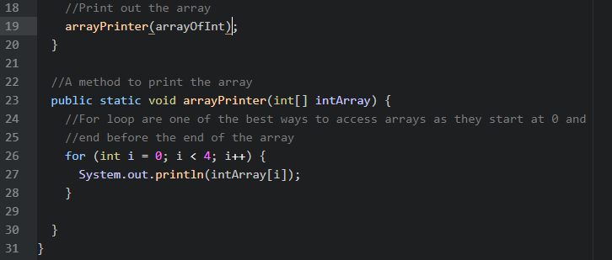
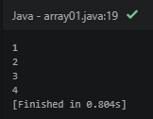
A method to print out the array

Slide 10
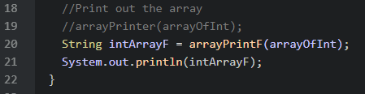
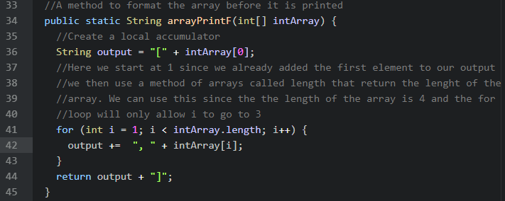
A method to print out the array ‘formatted’

Slide 11
TANGENT: Overloading
Overloading is a powerful tool when creating methods
Occasionally we want to create a method, say adding, but there are multiple input types that are possible
This is where overloading comes in

Slide 12
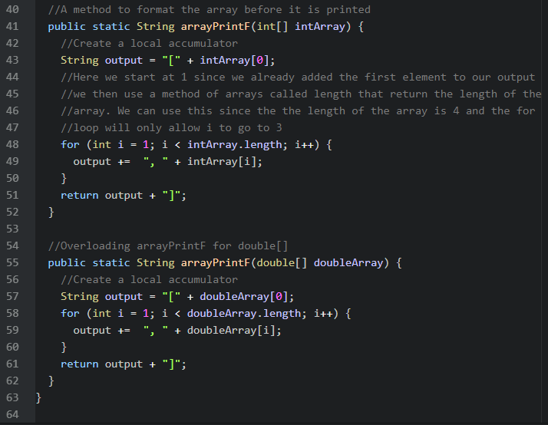
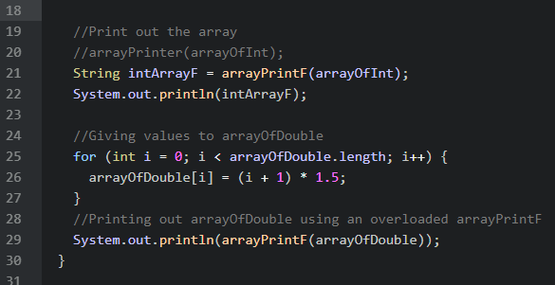
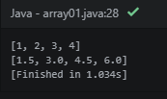
TANGENT: Overloading

Slide 13
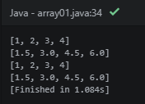

Arrays Library
The easiest way is importing the Arrays library and using it toString method to output as string

